Slide 1

CAPSTONE PROJECT TODO TRACKER
NIIT-WAVE-14/15
SOUVIK
SAI PRASHANTH
UMESH BARATHWAJ
TEAM-4

Slide 2

PROJECT-Agenda
"TODO-LIST" application is used To remind things and When we try to keep too many things in our mind, we end up forgetting some important things.
To-Do List Apps helps us stay organized in our life. we can note down anything running in
our head like personal, professional or any other tasks we need to do. These apps come with tons of useful options like scheduling, recurring, tracking, etc.

Slide 3










TECHNOLOGIES
FRONTEND
BACKEND

Slide 4
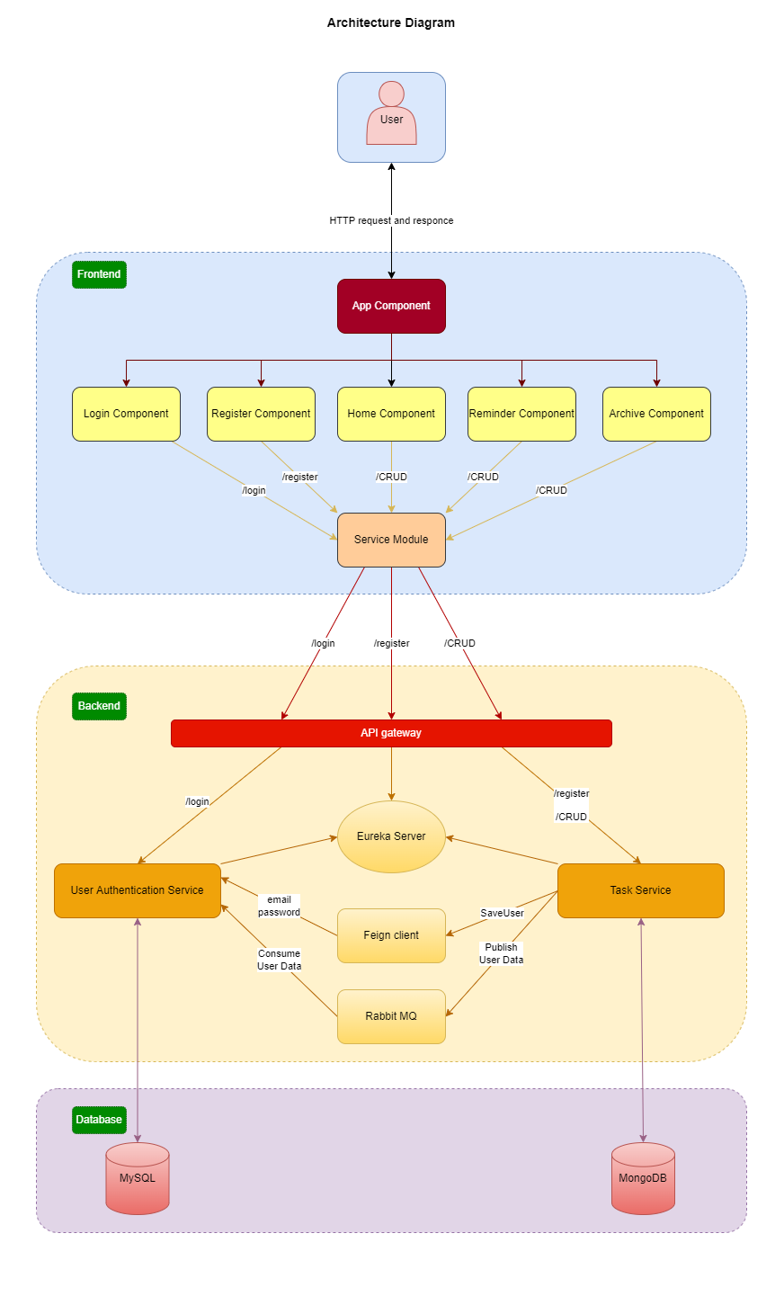
ARCHITECTURE DIAGRAM

Slide 5
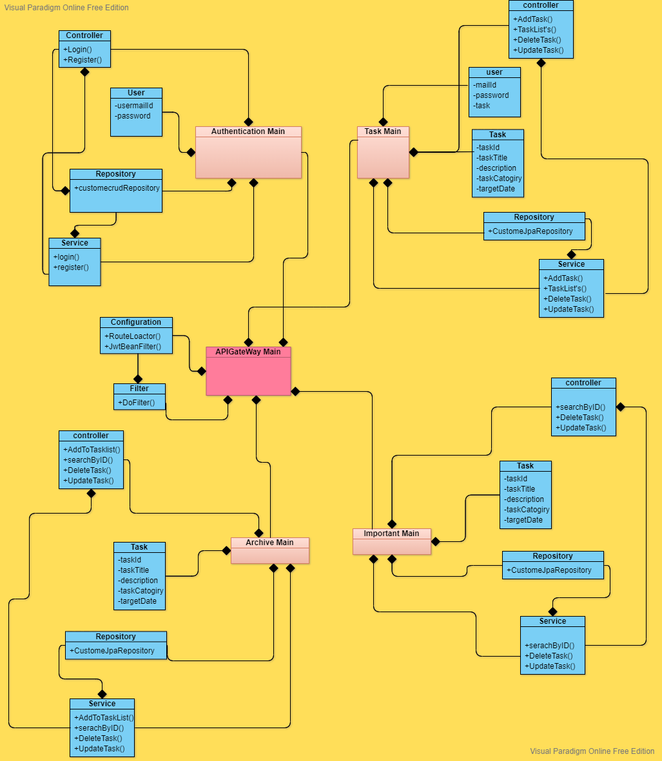
Class diagram

Slide 6
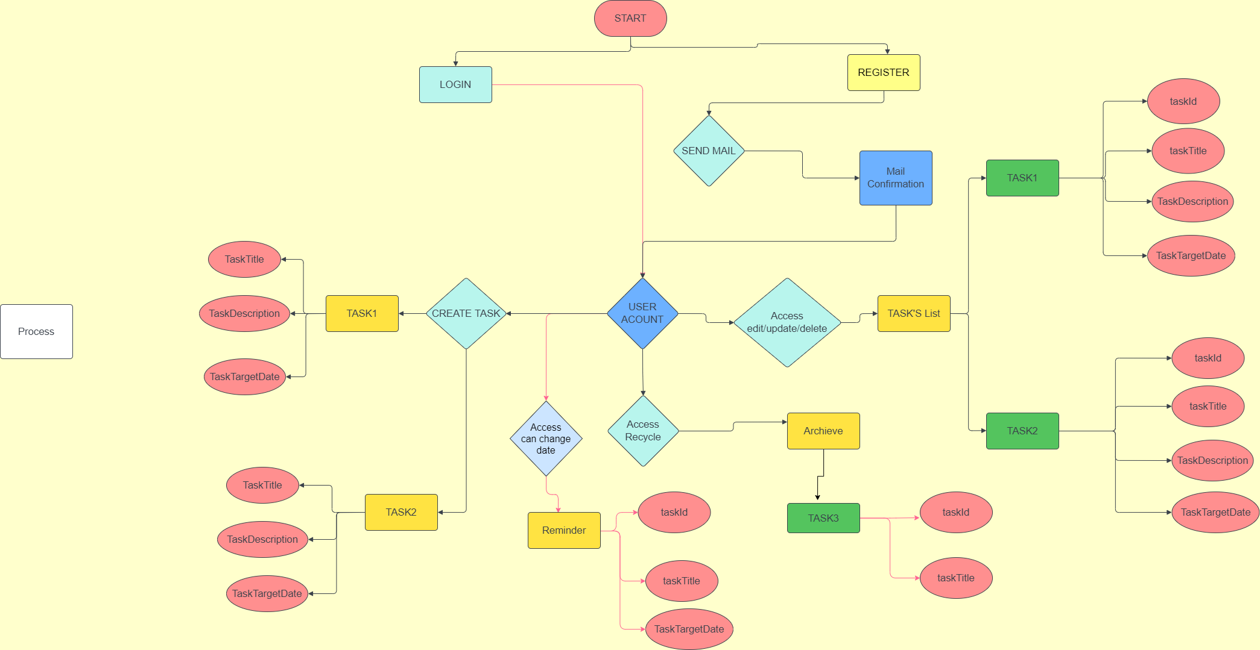
Workflow diagram

Slide 7

APPLICATION FEATURES
Add Task
Make Important Task
Make Archive Task
Delete Task
Update Task.
Set Task to Completed

Slide 8
THANK YOU

